Slide 1

Department of Computer Science and Engineering
UNIVERSITY EVENT ANALYTICS PLATFORM
Review-4
Team Number:24
Name: Roll Number:
K Dharani Harika 2420030304
T Lasya Priya 2420030258
V Durga 2420030184
Under the guidance of:
Dr.N. Sirisha
Associate Professor
Koneru Lakshmaiah Education Foundation

Slide 2
Existing vs our proposed system
Parameter | Existing System | Our Proposed System
Attendance | Manual/basic scanning | QR-based automated check-in
Real-time Monitoring | Limited or delayed | Real-time monitoring using Redis
Data Streaming | Limited/no live streaming | Kafka-based real-time streaming
Data Storage | Fragmented data sources | Centralized PostgreSQL
Dashboard | Limited/no analytics dashboard | Interactive Streamlit dashboard
Feedback Analysis | Manual/basic analysis | Automated sentiment analysis
Attendance Prediction | Limited/unavailable | ML-based attendance forecasting
Personalization | Limited recommendations | Participation-based event recommendations

Slide 3
Parameter | Existing / Traditional Approach | Our Project | Measured Improvement / Result
Event Registration | Manual / separate systems | Digital registration | 2094.12 ms average latency
Attendance Tracking | Manual / basic scanning | QR-based check-in | 4161.12 ms average latency
Real-time Monitoring | Delayed / unavailable | Redis live counter | 2048.00 ms response
Data Streaming | Limited / no streaming | Kafka event streaming | Real-time processing implemented
Data Storage | Fragmented data | Centralized PostgreSQL | Centralized event data
Feedback Analysis | Manual / basic ratings | VADER sentiment analysis | 0.2835 average sentiment score
Attendance Prediction | Limited / unavailable | ML-based forecasting | Forecast generated
Recommendations | Limited / unavailable | Participation-based recommendations | Recommendation module implemented
Event Analytics | Basic reports | Interactive dashboard | Live attendance + analytics
System Throughput | Manual processing | Automated API processing | 0.47 requests/sec measured

Slide 4
Key improvements
Automated Attendance: Replaced manual attendance with QR-based student check-in.
Centralized Data: Integrated event, student, registration, attendance, and feedback data into one platform.
Real-Time Processing: Implemented Kafka for real-time check-in event streaming.
Live Monitoring: Used Redis to maintain and display live attendance counts.
Data Analytics: Created a data warehouse for historical event and attendance analysis.
AI Analysis: Added sentiment analysis for feedback and ML-based attendance forecasting.
Dashboard: Developed an interactive Streamlit dashboard for live event monitoring and analytics.
Personalization: Implemented participation-based event recommendations for students.

Slide 5
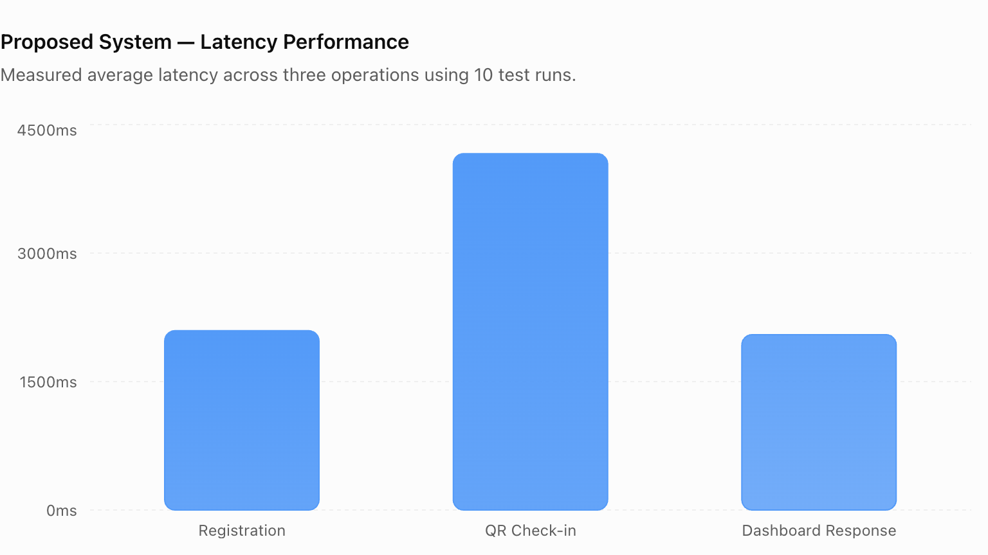

Slide 6
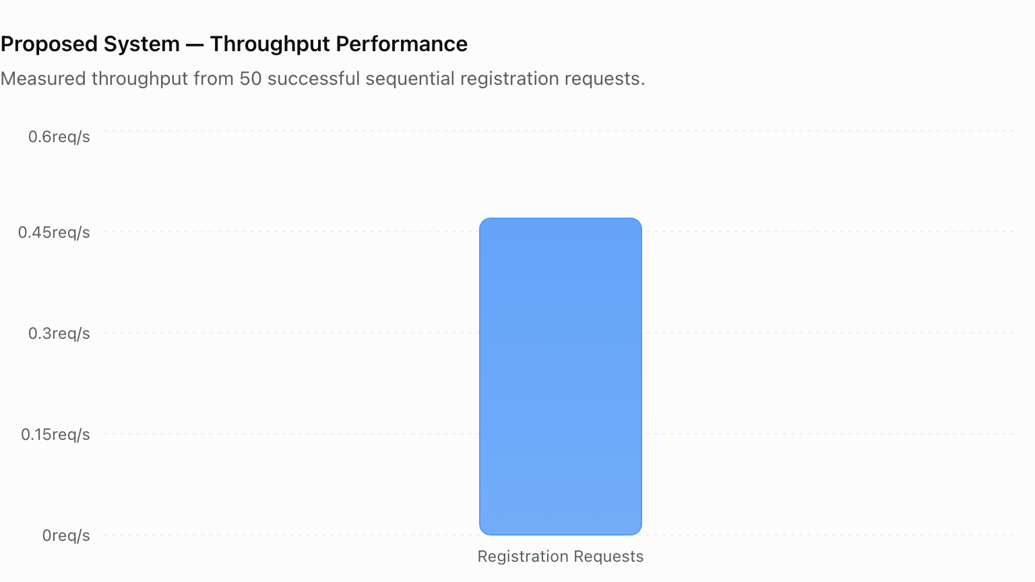

Slide 7
Performance metrics.
Registration Latency: 2094.12 ms average response time.
QR Check-in Latency: 4161.12 ms average end-to-live-counter latency.
Dashboard Response Latency: 2048.00 ms average response time.
System Throughput: 0.47 requests/second in sequential testing.
Attendance Rate: 73.3% for the test event.
Average Feedback Rating: 3.18 / 5.
Average Sentiment Score: 0.2835.
Benchmark Testing: Latency metrics were measured across 10 test runs.

Slide 8
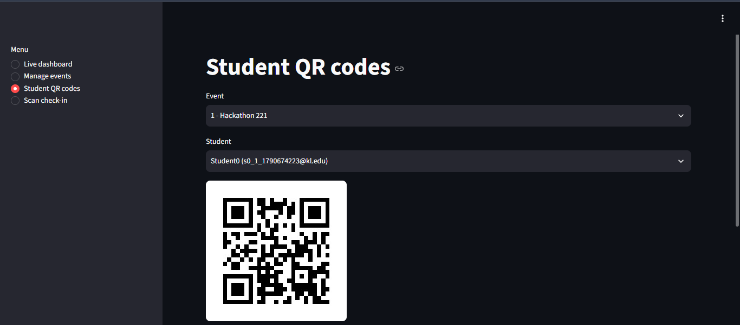
Implementation:

Slide 9
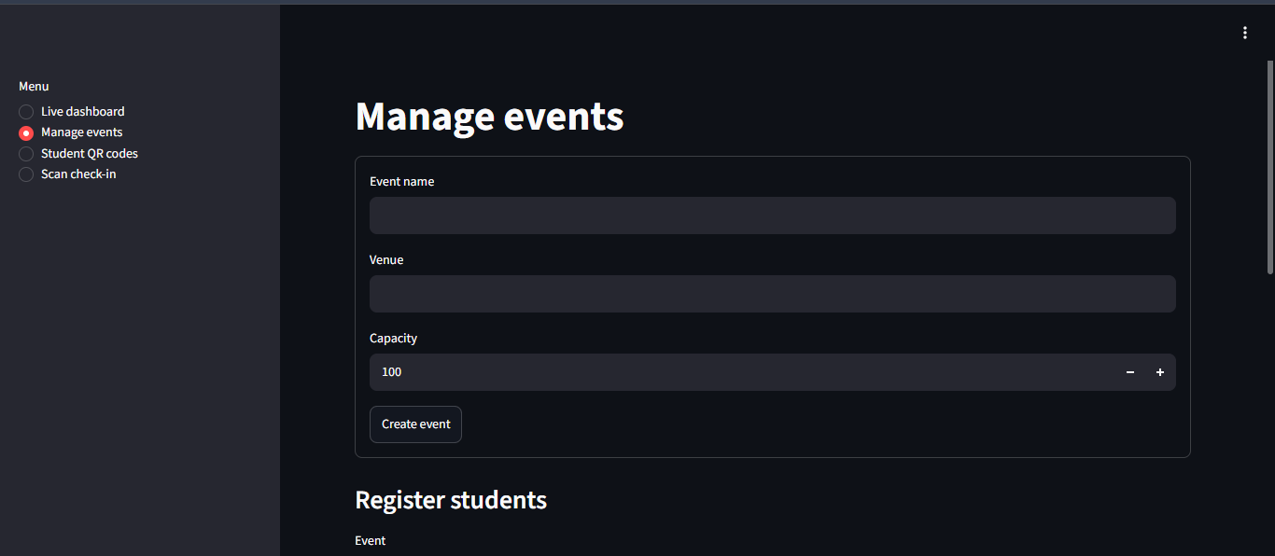

Slide 10


Slide 11
REFERENCES:
Joshi et al. — RFID-based attendance systems and challenges in dense event environments. Academia.edu.
Abu Sneineh & Salah — QR-based attendance systems and security limitations of static QR codes. DOAJ.
Aung & Maw — Big-data processing and Kafka/Storm-based streaming architecture. MERAL.
Falk et al. — Kafka-based stream processing and real-time data transformation. ORBilu.
Dayal et al. — Data-flow architecture and ETL/ELT-based processing frameworks.
St. Petersburg Mathematical Society / SPBU.
Zulfa et al. — Redis-based data processing and caching applications. JTSISKOM.
Nasim et al. — Sentiment analysis and opinion mining techniques. IBA Research Repository.

Slide 12
CONCLUSION:
- Developed a centralized University Event Analytics Platform for managing event data.
- Automated student attendance using QR-based check-in.
- Implemented Kafka-based real-time streaming for attendance events.
- Used Redis for live attendance monitoring and PostgreSQL for persistent storage.
- Built an ETL and data warehouse layer for historical event analytics.
- Integrated sentiment analysis and attendance forecasting to generate useful insights.
- Added participation-based event recommendations for students.
- The system provides a foundation for real-time, data-driven and scalable university event management. fde_project

